Slide 1
Wanderlust
An Android App which makes your travel experiences eternal
Gouthaman Senthilkumar
www.linkedin.com/in/gouthaman-senthilkumar-7095aa2a2

Slide 2
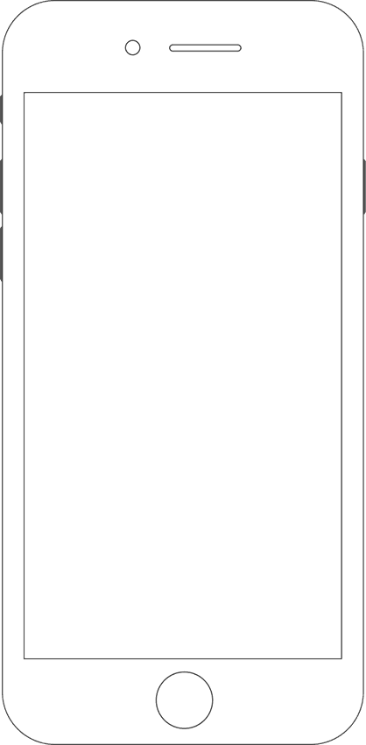
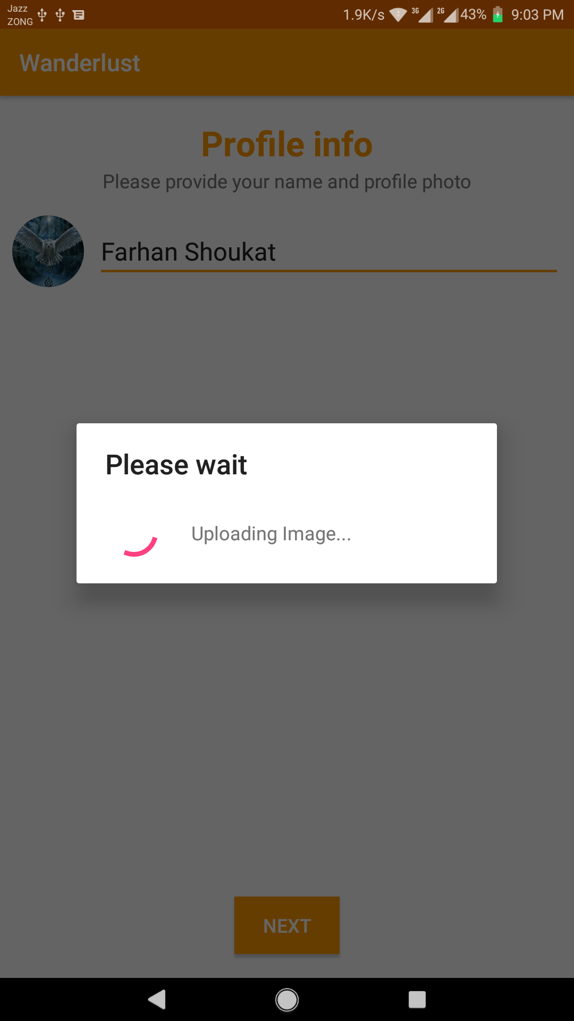
HCI Design Rules Followed
Strive for consistency
Design dialogs to yield closure
Offer informative feedback
Prevention of errors
Keep users in control
Reduce Cognitive Load

Slide 3
1- Strive for Consistency
Consistent look and feel of colors, fonts, terminology is maintained throughout the app.

Slide 4
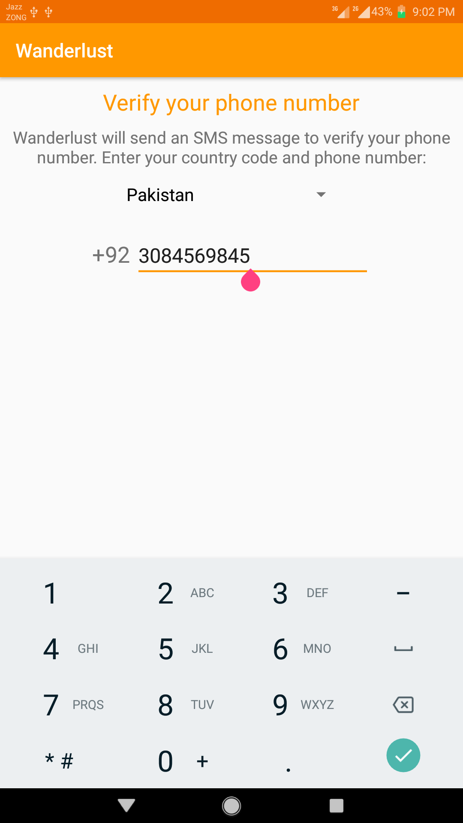
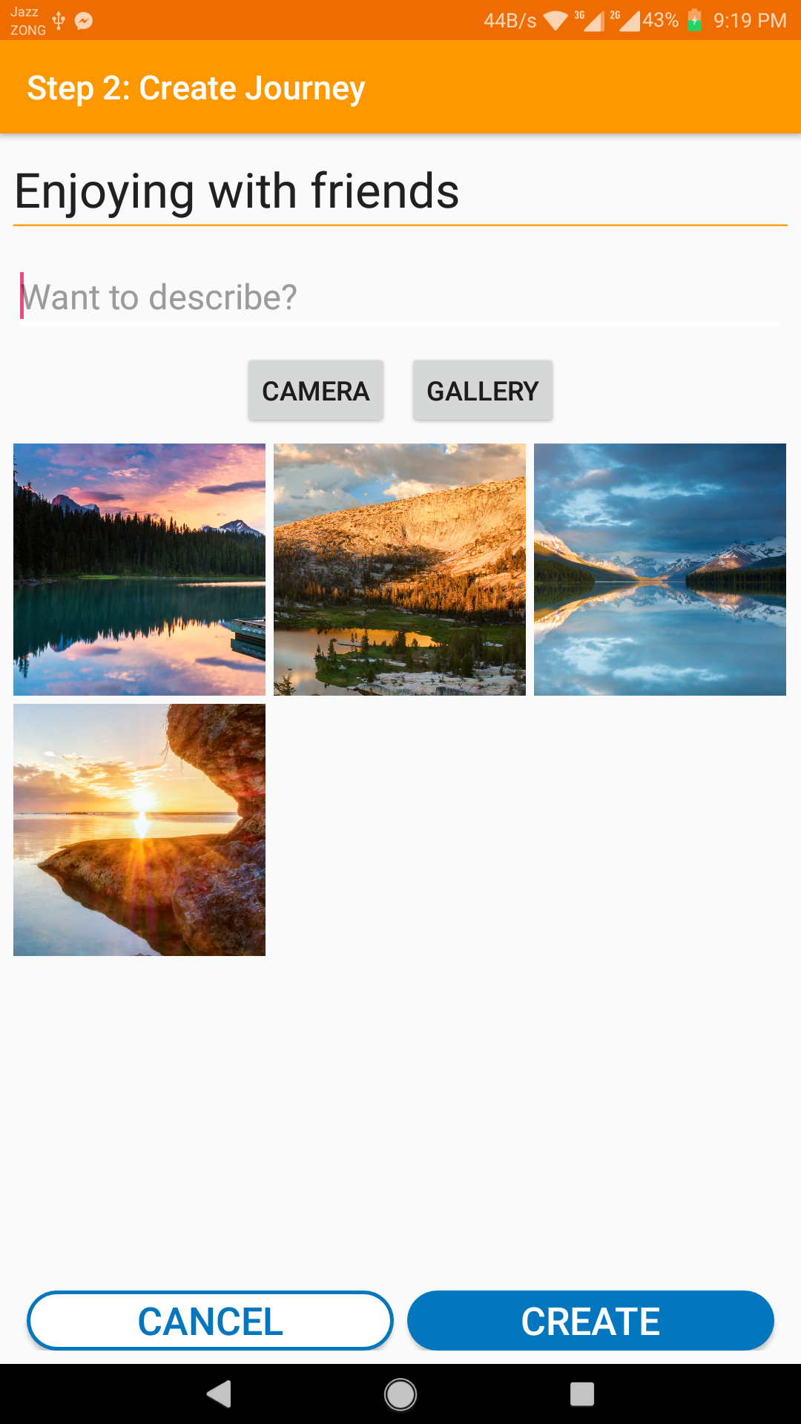
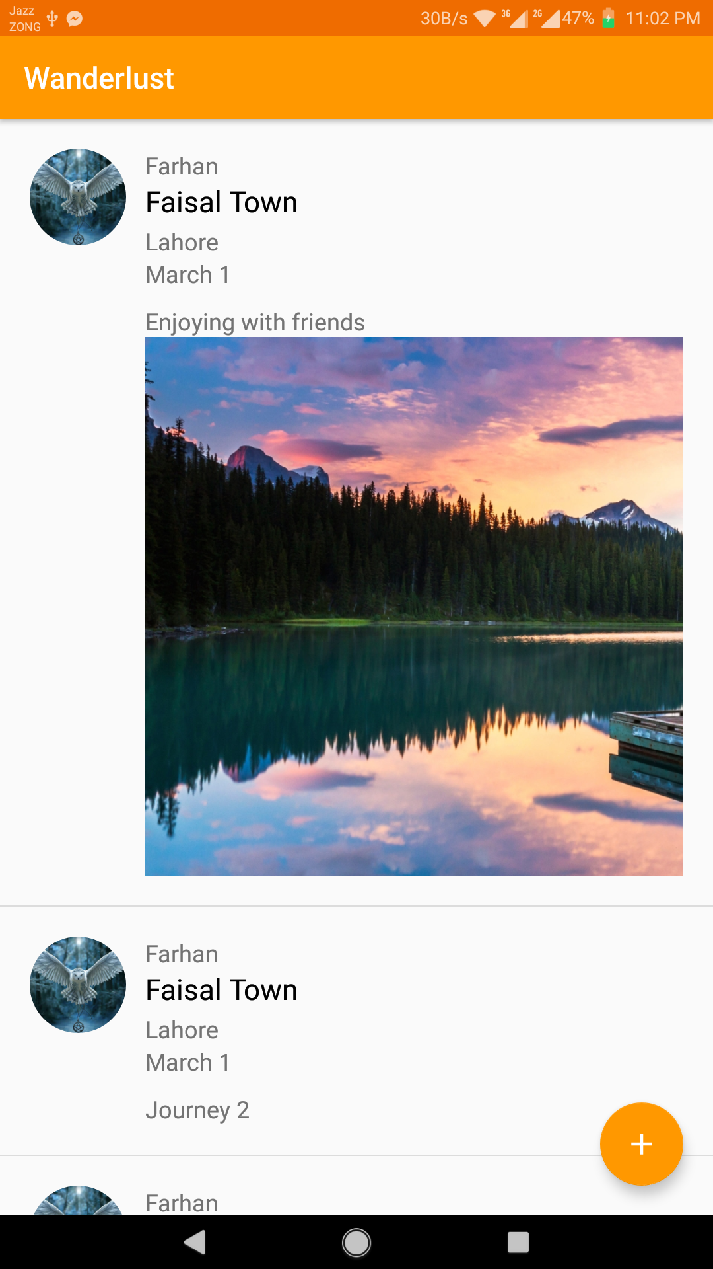
Consistent Theme

Slide 5
2- Design Dialogs to yield Closure
The user is shown the stages of the process, so after completion of process it gives the user a sense of accomplishment.

Slide 6
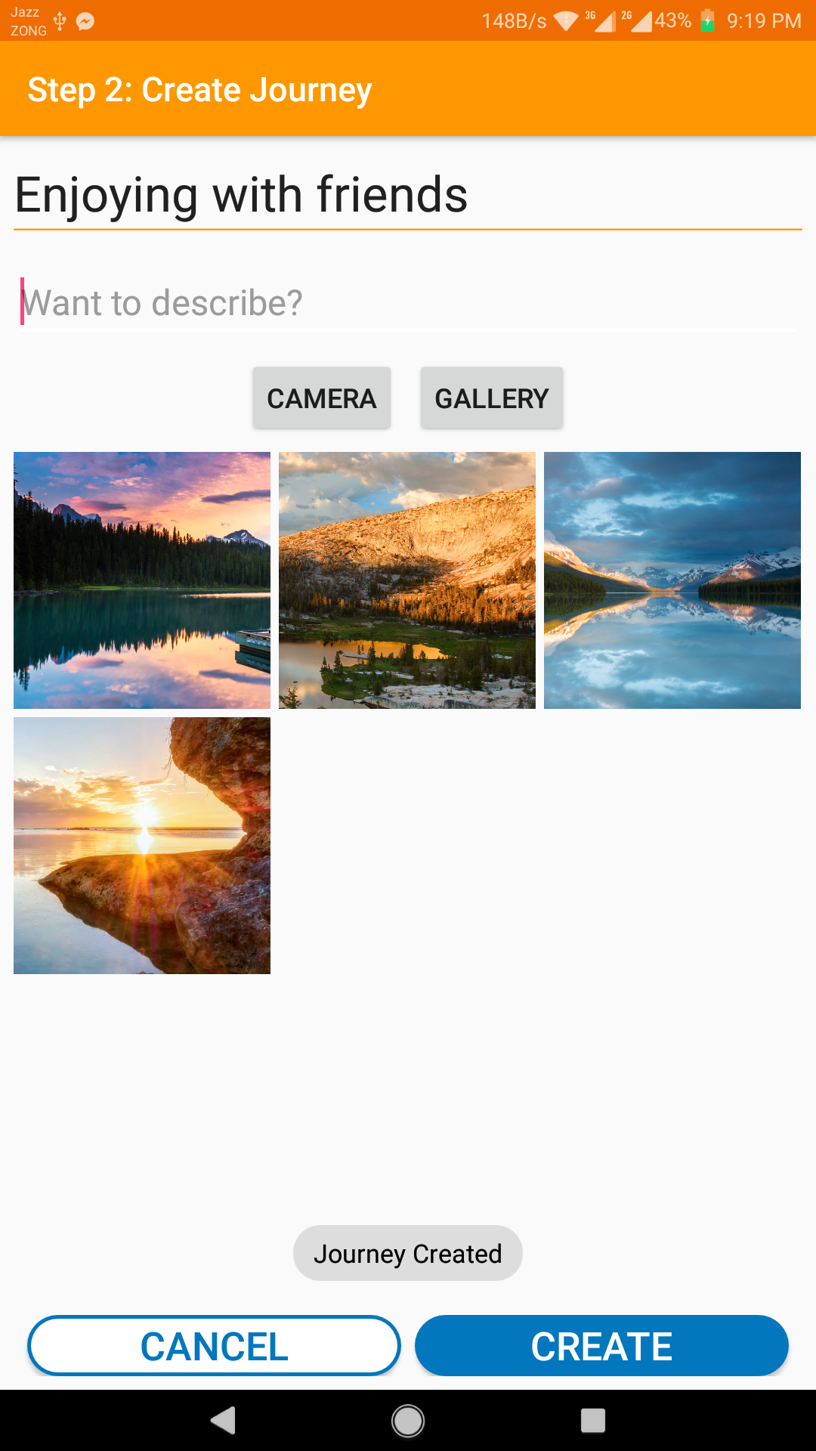
Dialogs to Yield Closure

Slide 7
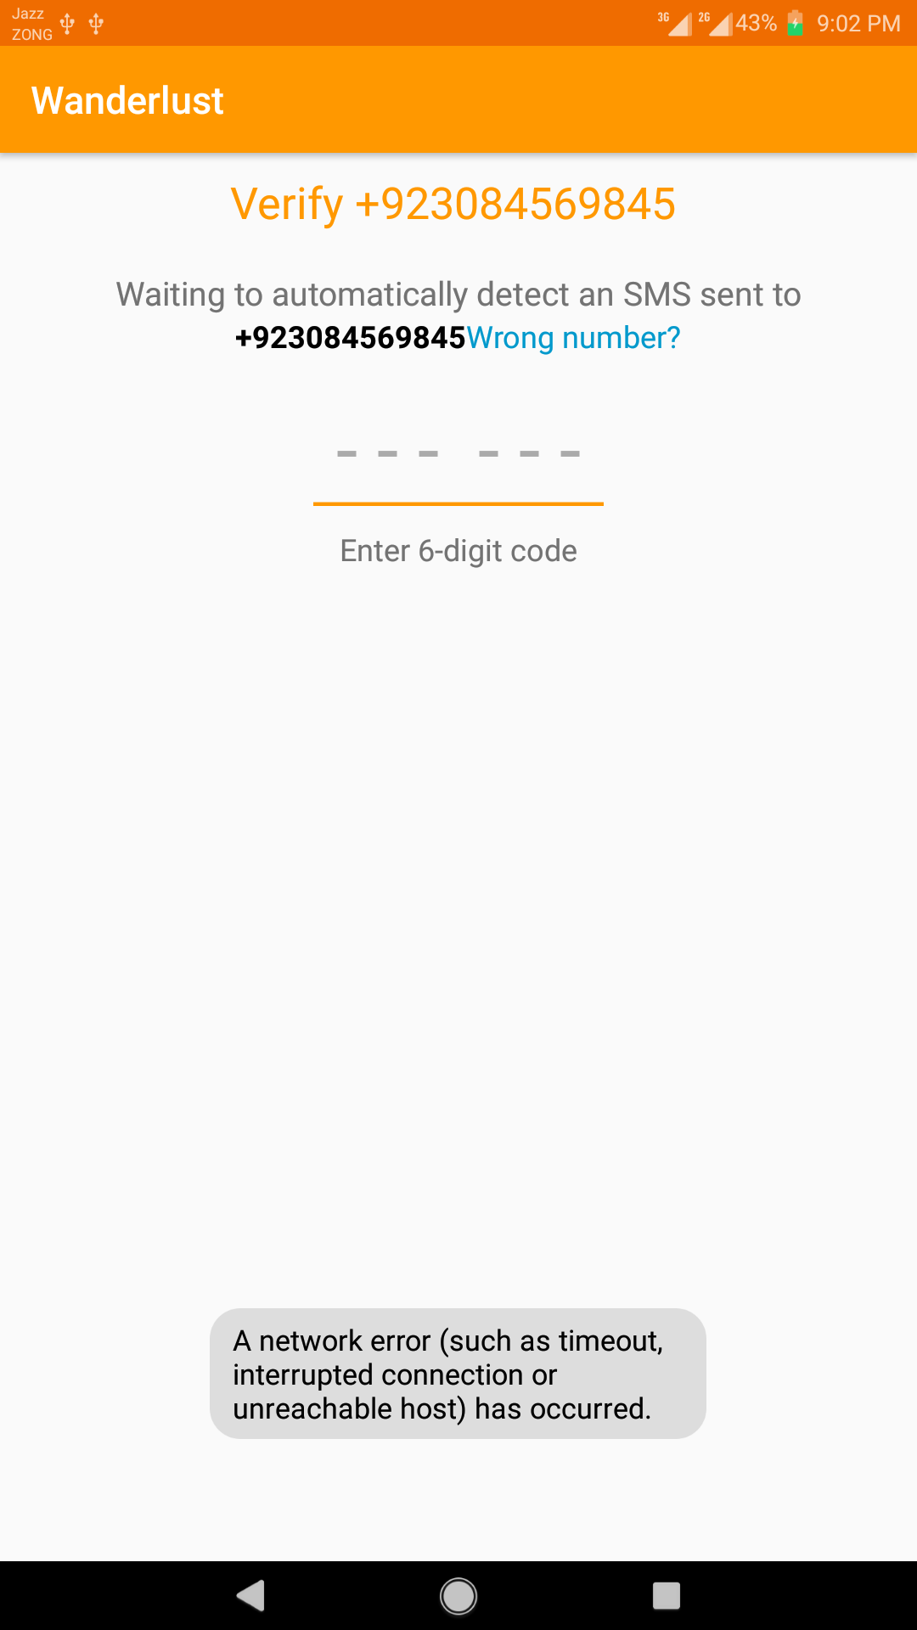
3- Offer Informative Feedback
We tried to offer informative feedback on every action of user. E.g
Here an error message is shown that Internet isn’t connected, therefore the server can’t send the verification code for authentication.

Slide 8
4- Prevention of Errors
Due to proper validation we are handling prevention of errors according to golden rules.
E.g
In numeric field you can not write english alphabets. So user is stopped in the first place from making an error.

Slide 9
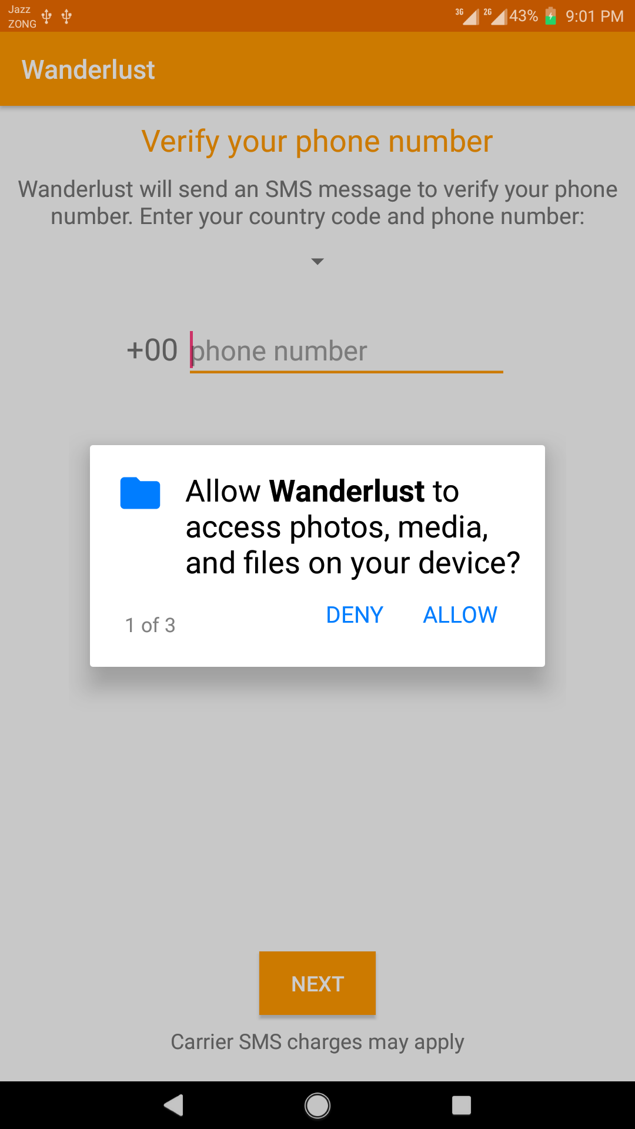
5- Keep Users in Control
User is the initiator of every action so he feels that he is in control over the app.
E.g
User is in control to allow certain permissions for app.

Slide 10
6- Reduce Cognitive Load
Lengthy form is compacted to fit a single display to avoid memory load.
E.g
The form of Create Journey is compacted to fit a single display.

Slide 11
UI / UX Design Guidelines Followed
Universal Usability - Language Support
Visibility - Navigation Bar
Splash Screens
Audio Feedback using Text to Speech
Enhanced Accessibility - Providing a map with journeys as labels

Slide 12
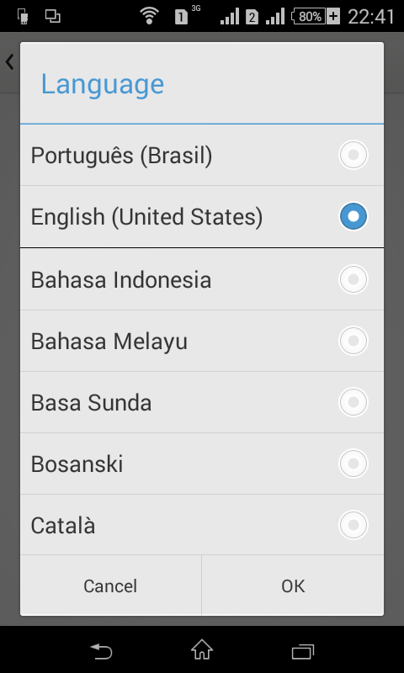
1- Universal Usability: Language Support
Providing the support to change language will make our apps usable for a broad range of users. Hence we have incorporated support for Urdu, English and Spanish.

Slide 13
2- Visibility - Make Navigation Self-Evident
All the cool features and compelling content in the world won’t matter if people can’t find it. So don’t hide important features. Hence we have added a bottom navigation bar which presents the user with the most important modules at one place

Slide 14
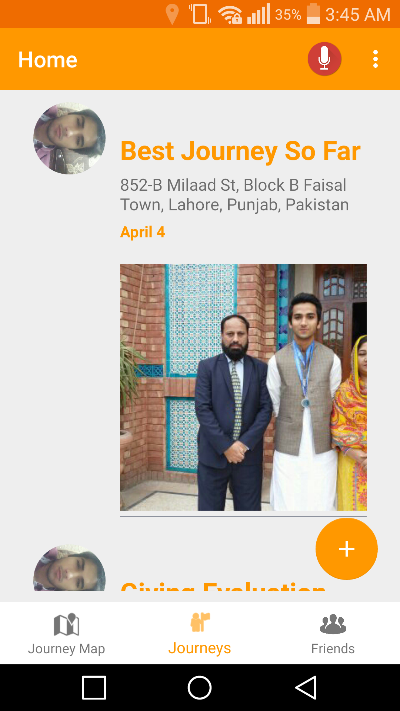
Enhanced Visibility – Navigation Bar

Slide 15

3- Splash Screens
Splash screen is new trend in apps and its attractive for users, hence we incorporated it.

Slide 16
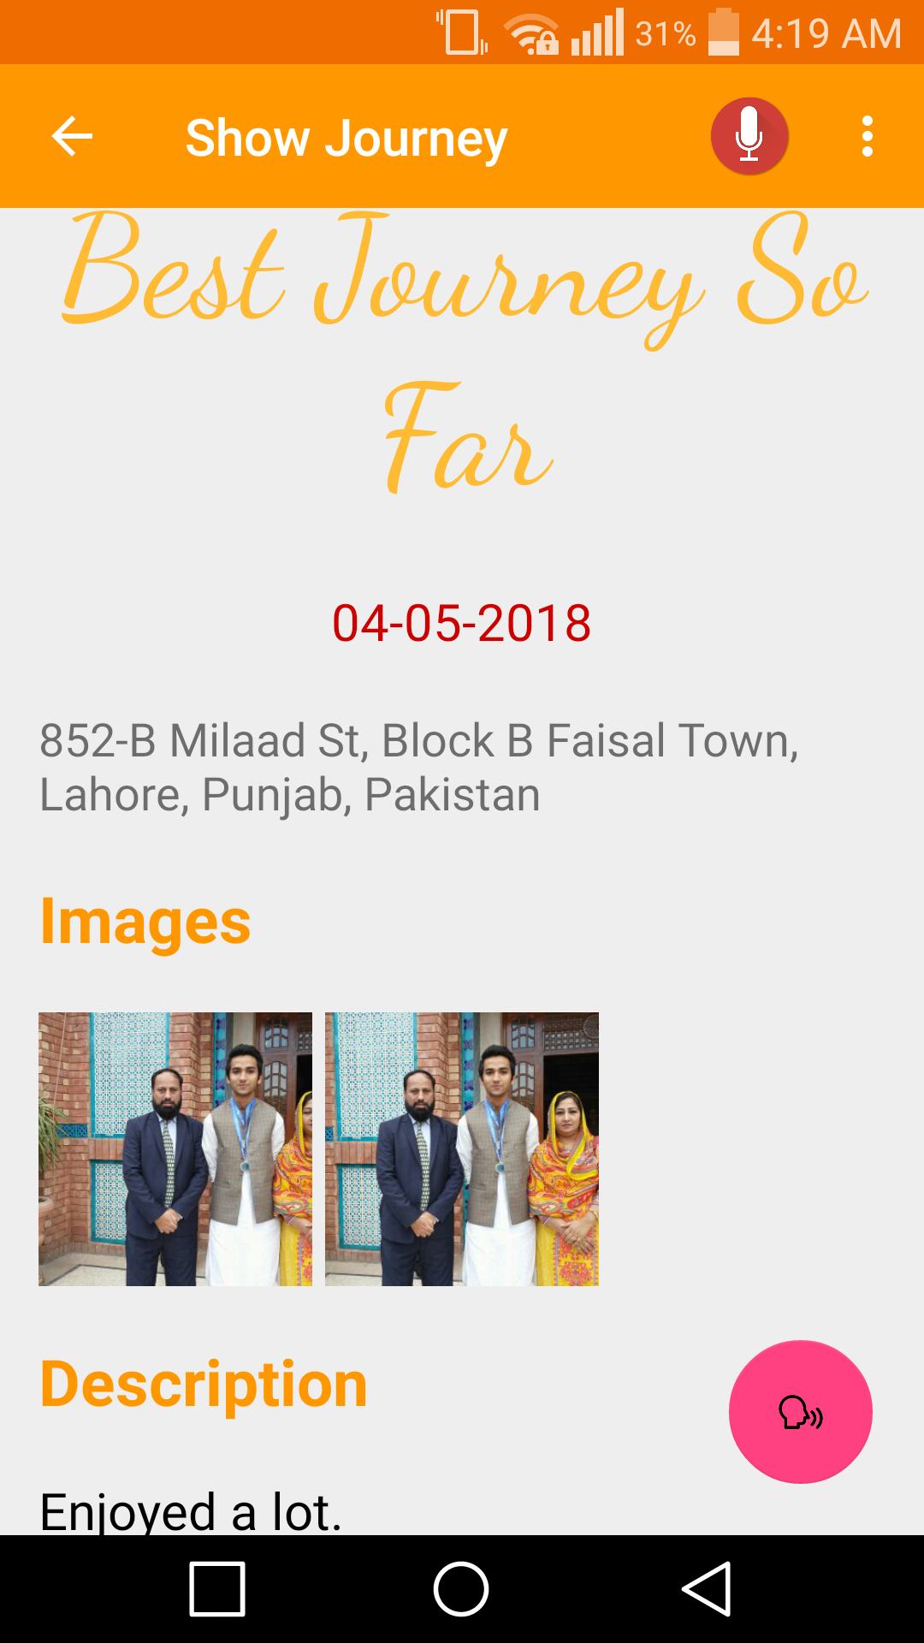
4- Audio Feedback using Text to Speech
The journey description can be read aloud for users with some vision problems. The pink coloured icon is the text to speech button.

Slide 17
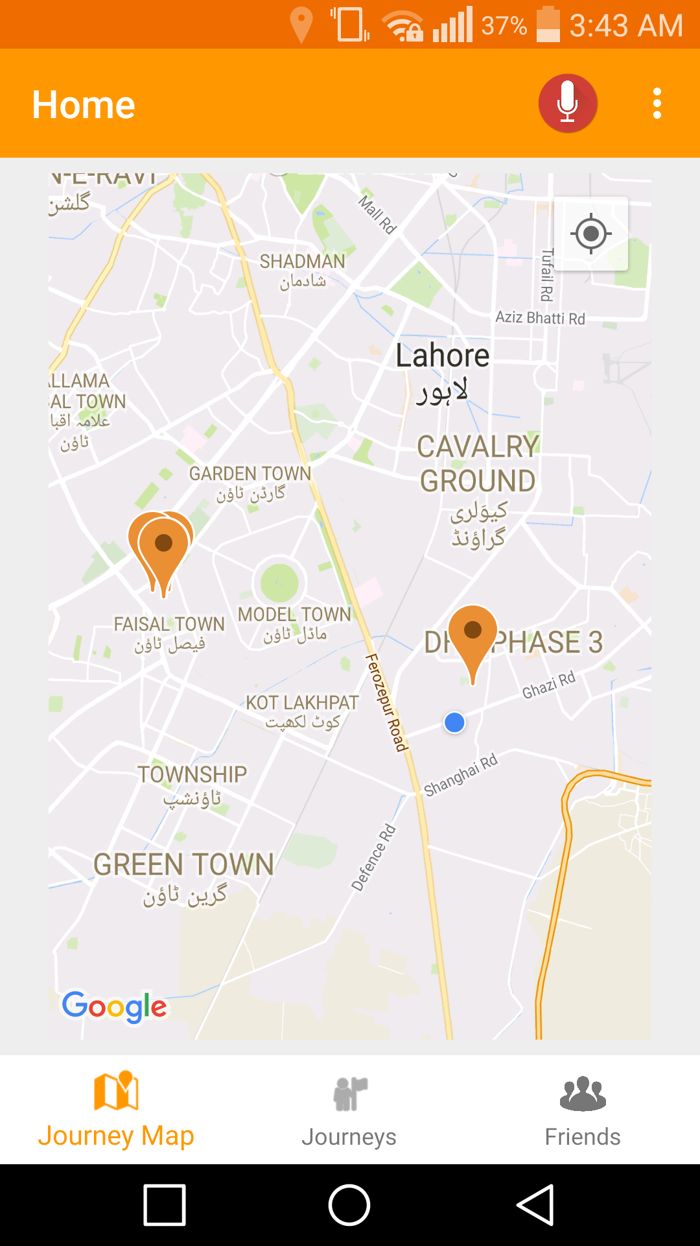
5- Enhancing Accessibility: Using a Map with Journeys as labels
A map is created with labels placed on those locations which the user has visited, making the corresponding journey easily accessible.

